Slide 1
CMSVS — Hosted Multimodal Document Validation
End-to-end system for extracting entities from documents and validating document pairs through a live hosted application
Hosted Demo: https://jmethew765-ml4.hf.space/
Contributors:Mallesh Mayara (21f2001118)
Mayank Dode (22f1000781)
Karthik Ganesh (21f2000775)
Ayush Verma (21f3000500)

Slide 2
Problem Statement
Document validation and comparison are still largely manual in many real-world workflows
Users often need to review PDFs, scanned documents, or forms and verify whether important values match across files
This process is slow, repetitive, and prone to inconsistency, especially when documents are long, differently formatted, or partially unclear
Key challenges:
1
2
Manual review takes time
Important mismatches can be missed
3
4
Different document formats make comparison harder
Business users need faster and more reliable validation support

Slide 3
Objective & Scope
The goal of CMSVS is to build a practical system that can automatically read documents, extract important information, and validate whether two documents agree semantically.
Project objectives:
01
02
03
Support both PDFs and image/scanned documents
Extract structured entities from a single document
Compare entity values across document pairs
04
05
Provide a simple hosted interface for user interaction
Enable reuse across domains through configuration-driven design
Development Stages
Define the problem and project requirements
Collect and prepare document data
Build document ingestion for PDFs and images
Extract text and structured entities
Develop semantic comparison logic
Design the hosted user interface
Test and refine the end-to-end workflow
Deploy the system for practical use
Rather than just building a model, we focused on creating a system that's actually usable end-to-end.

Slide 4
Methodology & Configuration
The project follows a pipeline-based methodology for document understanding and validation.
Pipeline-Based Approach
01
02
Define the target document domain and required entities
Prepare structured configurations describing what must be extracted
03
04
Process uploaded documents based on their format
Extract meaningful values from relevant content
05
06
Apply comparison logic across extracted outputs
Present final validation results through a user-friendly interface
Configuration Strategy
Instead of hard-coding rules, CMSVS uses domain-specific configuration files tailored to each document type.
These configurations include sections, entities, keywords, and computed fields.
The approach was applied across two domains: Healthcare SBC and FUNSD forms.
By combining structured domain definitions with automated extraction and comparison, we created a reliable validation workflow.

Slide 5
System Architecture
CMSVS is designed as a modular system with three major layers:
Frontend:
Backend:
Hosted web interface for upload, selection, and result viewing
User-friendly dashboard for document processing
API layer that receives requests and manages processing
RESTful endpoints for extraction and validation
Core Pipeline:
Document ingestion and format detection
OCR for text extraction from PDFs and scans
Dense retrieval for section identification
Multimodal extraction for entity recognition
Expression evaluation for computed fields
Semantic validation for document comparison
The modular design gives each part of the workflow a clear role, making it easier to manage, test, and extend.

Slide 6
Pipeline & Core Components
The working flow depends on the input type.
Processing Paths
PDF Path:
Image Path:
01
01
Document upload
Image upload
02
02
OCR reads page content
Direct visual extraction of important information
03
03
Retrieval identifies the most relevant sections
Expression evaluation
04
04
Multimodal extraction identifies key values
Semantic validation if used in pairwise comparison
05
Expression evaluation computes derived fields
06
Semantic validation compares outputs when two documents are provided
Core Components
OCR
Dense Retrieval
Extracts text from PDFs and scans.
Finds the most relevant sections for downstream processing.
Multimodal Extraction
Expression Evaluation
Identifies key values from text and visual inputs.
Computes derived fields from extracted data.
Semantic Validation
Compares outputs when documents are processed together.
This unified approach handles everything from text-heavy PDFs to scanned or image-based documents in a single workflow.

Slide 7
User Experience and Interface
The project is available as a live hosted web application for demonstration and use.
Main user flow:
01
02
Select a domain configuration
Set the confidence threshold
03
04
Upload one document for entity extraction
Upload two documents for pairwise validation
05
06
View extracted entities and validation summaries
Review matches, mismatches, and output reports
It's easy to demonstrate and proves the project is deployment-ready—not just theoretical.

Slide 8
Results and Evaluation Output
CMSVS produces meaningful outputs that support both user understanding and project evaluation.
Outputs include:
Structured entity extraction reports
Validation summaries showing matched and mismatched fields
Confidence-based review indicators
Evaluation-ready output for comparison with reference results
Impact of results:
Users can quickly understand what was extracted
Document differences become easier to identify
The project supports both practical usage and systematic evaluation
These outputs show how the system converts complex document content into something clear, useful, and easy to review.

Slide 9
Conclusion and Key Takeaways
CMSVS delivers a complete hosted document validation product that covers the full journey from problem definition to deployment.
Key takeaways:
It addresses the real problem of slow and inconsistent manual document validation
It uses a clear methodology based on configurable extraction and semantic comparison
It supports multiple document formats including PDFs and scanned images
It produces structured outputs that help users review and validate documents efficiently
It is deployed as a live system, demonstrating practical usability
CMSVS demonstrates how a configurable multimodal pipeline can become a practical, scalable document validation solution ready for real-world use.

Slide 10

SYSTEM OVERVIEW
What the System Does
CMSVS handles the full document validation lifecycle — from raw input to structured, actionable output.
Entity Extraction
Pairwise Validation
Extracts named entities from PDFs and scanned or form images using multimodal processing.
Compares two documents for semantic consistency and flags mismatches.
Structured Reports
Domain Configurable
Produces validation reports and M2 ground truth output for downstream evaluation.
Supports configurable entity schemas for healthcare SBC and FUNSD form domains.

Slide 11
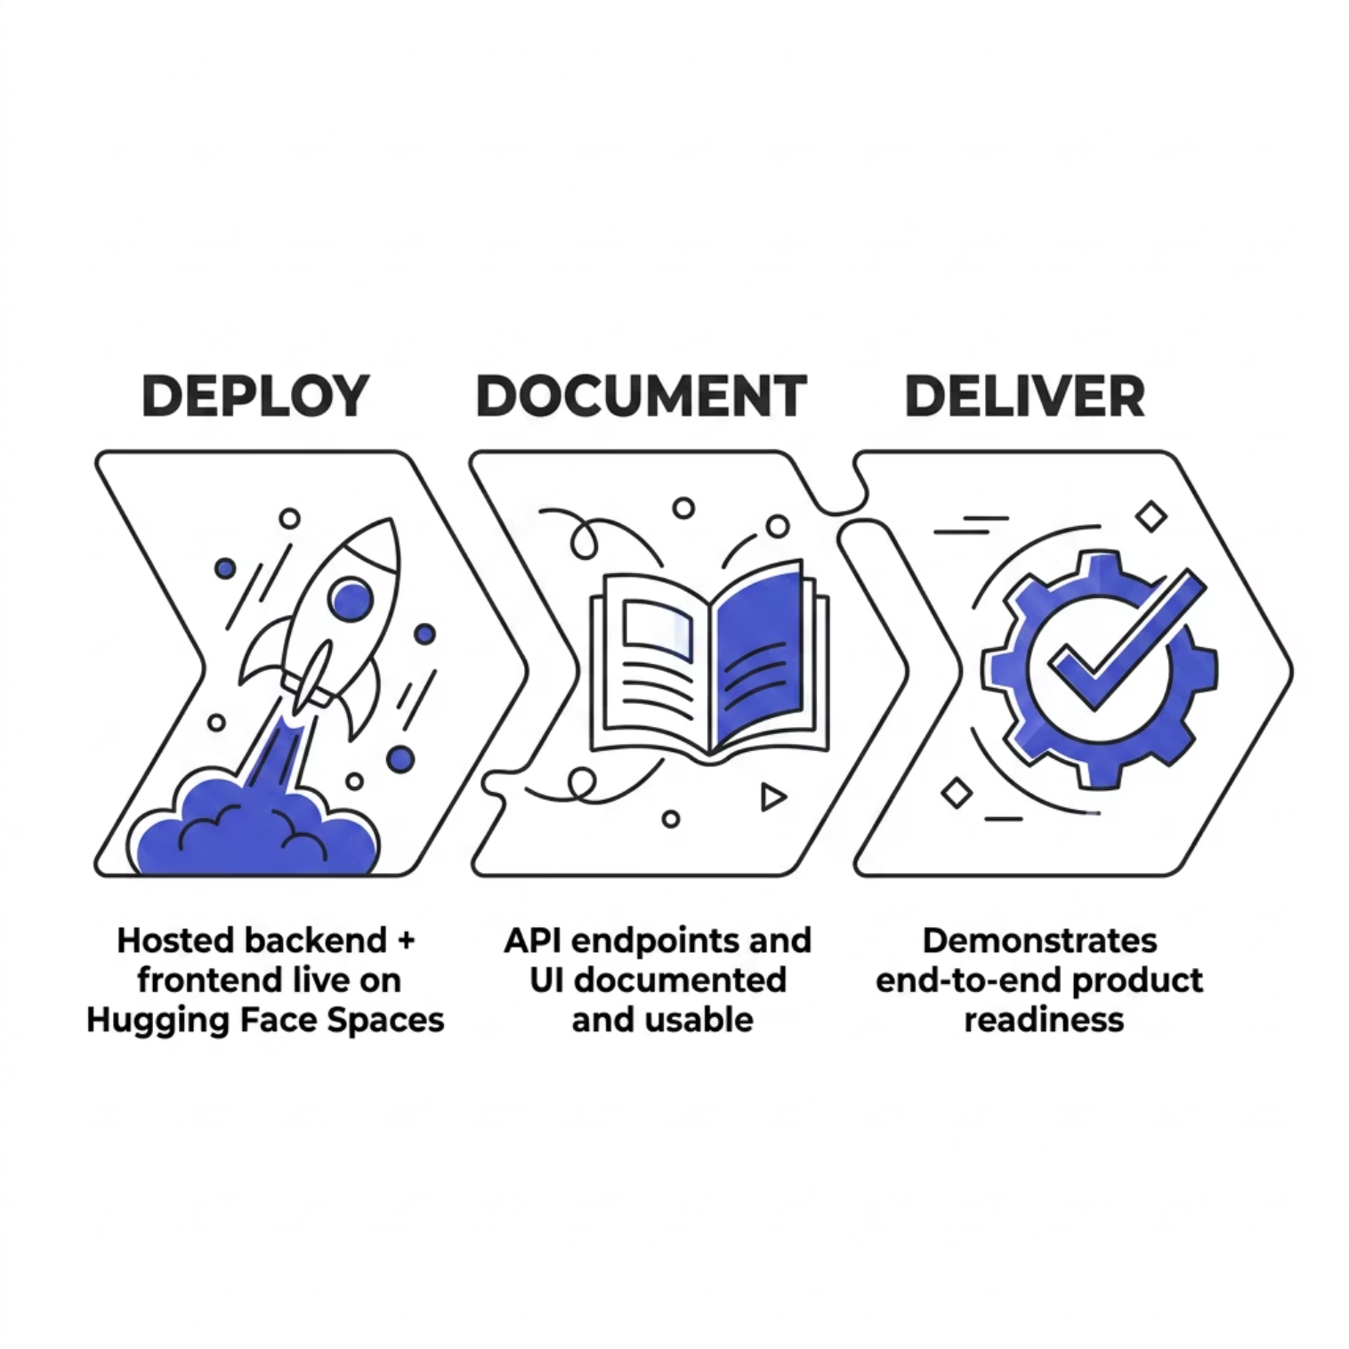


MILESTONE 6 FOCUS
Deployment & Documentation
What We Delivered
Milestone 6 centers on demonstrating a production-ready, fully documented system. The hosted backend and frontend are live, API endpoints are accessible, and the UI is usable by evaluators without local setup.
All Milestone 6 requirements satisfied.

Slide 12
TECHNICAL ACHIEVEMENTS
Deployment Achievements
FastAPI Backend
Streamlit Frontend
Deployed RESTful API for entity extraction and pairwise validation with structured JSON responses.
Interactive UI for document upload, configuration selection, and result visualization.
Hugging Face Spaces
YAML Config Schemas
Fully hosted solution accessible via a public URL — no local installation required.
Runtime behavior is configurable via YAML domain schema files for flexible deployment.

Slide 13
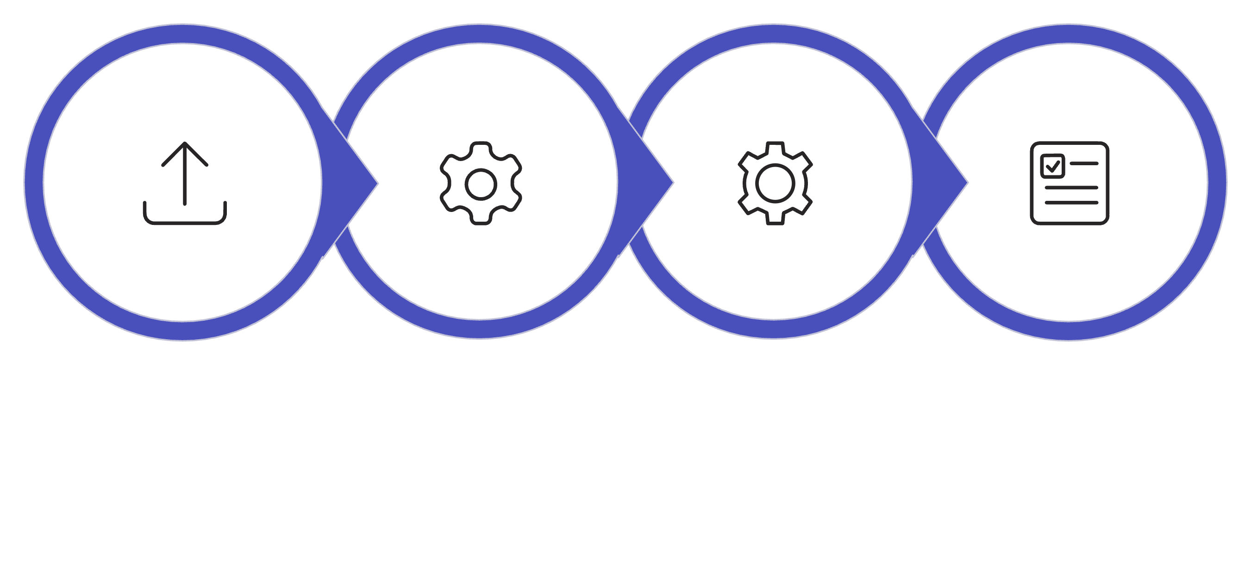
USER EXPERIENCE
User Flow & Interface
Select Config
Upload
Process
Review
The interface supports two primary workflows: single-document entity extraction and two-document pairwise validation. Users configure the domain schema and confidence threshold before processing, then receive a structured summary of validation status, matched and mismatched fields, and review flags for manual inspection.

Slide 14
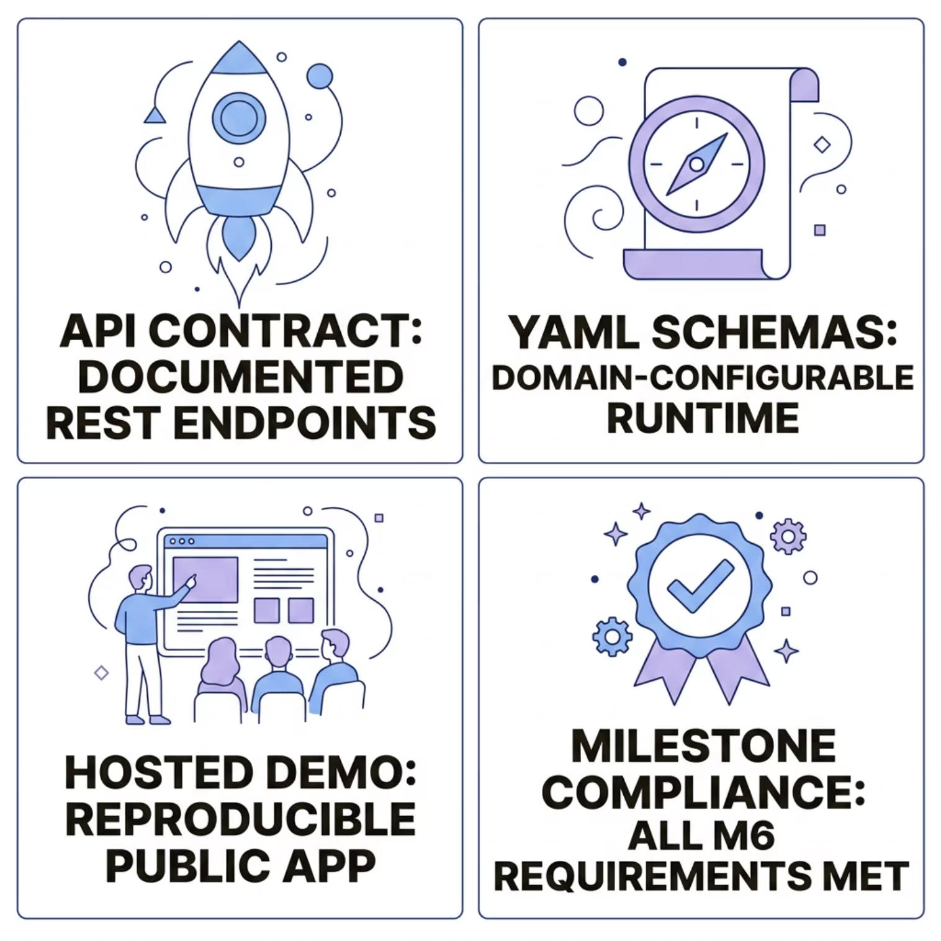
REPRODUCIBILITY
Documentation & Reproducibility
What's Documented
API Contract — Backend endpoints are documented and accessible for programmatic integration.
Runtime Config — YAML schema files define entity types and validation rules per domain.
Demo Flow — The hosted app provides a reproducible end-to-end demonstration.
Milestone Compliance — Deployment satisfies all Milestone 6 product delivery requirements.

Slide 15
CORE CAPABILITIES
Key System Strengths
Our solution is engineered for robustness and adaptability, excelling in critical areas of document processing and validation.
Practical & Deployable
Highly Configurable
A fully hosted solution, ready for immediate use without complex local setup.
Adapts to diverse document types and validation rules via flexible YAML schemas.
Multimodal Integration
Real-World Focus
Unifies OCR, intelligent retrieval, and advanced extraction for comprehensive validation.
Specifically designed to address the challenges of real-world document validation scenarios.

Slide 16

SUMMARY
Final Summary
CMSVS Milestone 6 delivers a live, hosted, end-to-end multimodal document validation product — combining OCR, retrieval, extraction, and semantic validation in a single deployable system.
🚀 Live Product
🔗 Integrated Stack
✅ Milestone Complete
Hosted demo proves deployment and documentation completion.
OCR + retrieval + multimodal extraction + semantic validation unified.
All M6 requirements for product delivery are satisfied.
Explore the live demo: https://jmethew765-ml4.hf.space/

